Slide 1


AVENTURE WORKS CYCLE
Presented by: Group 4
Members : Abhishek Jairaj Kunder
Anjali Kaushik Singh
Jay Parag Shah
Santhosh Kavala
B Shivani Reddy

Slide 2


INTRODUCTION
Adventure Works Cycles is a large, multinational manufacturing company.
The company manufactures and sells metal and composite bicycles to North American, European and Asian commercial markets.
Its base operation is located in Bothell, Washington.
The AWC transactional model consists mainly of 5 sub domains and they are namely
a) Sales
b) Purchasing
c) Person
d) Production
e) Human Resources
The AWC deals with several sales territory country:

Slide 3

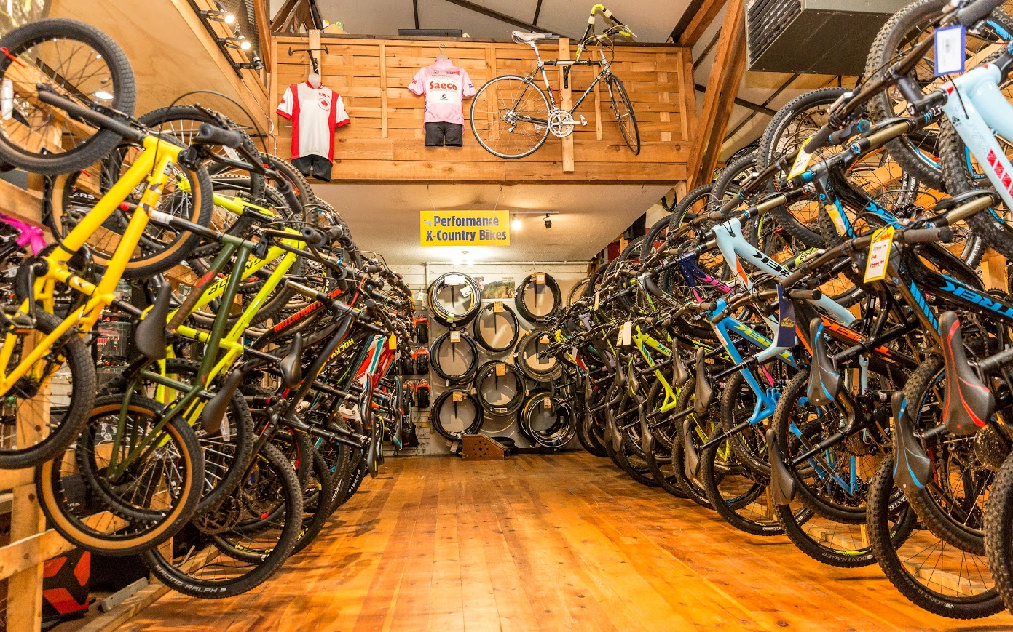


KPI

Slide 4

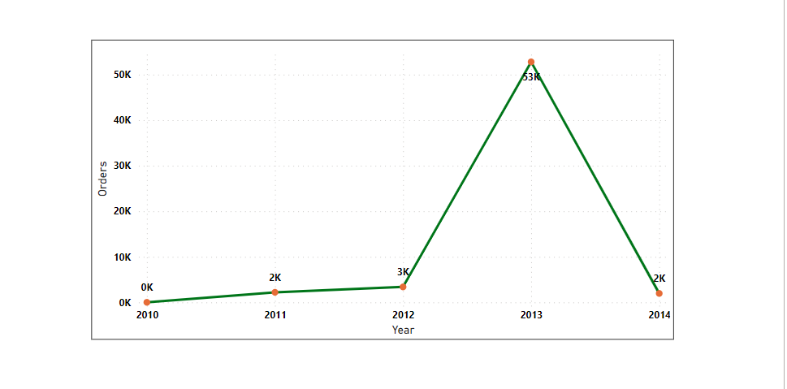
TOTAL ORDERS
KPI

Slide 5
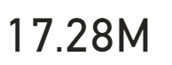
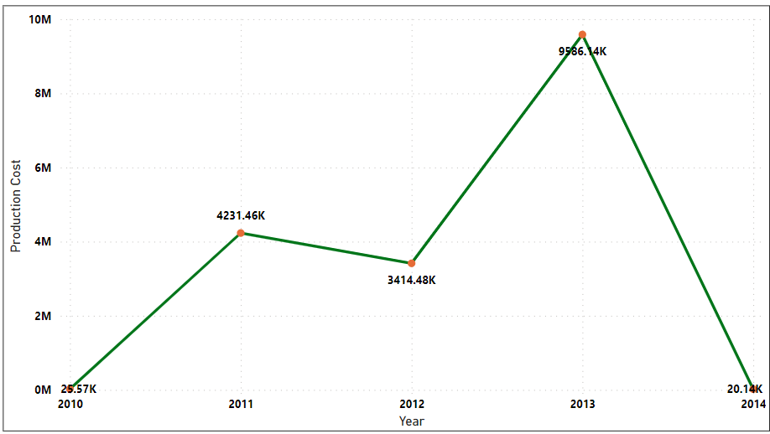
TOTAL PRODUCTION COST
KPI

Slide 6
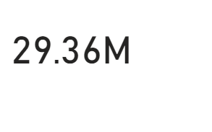
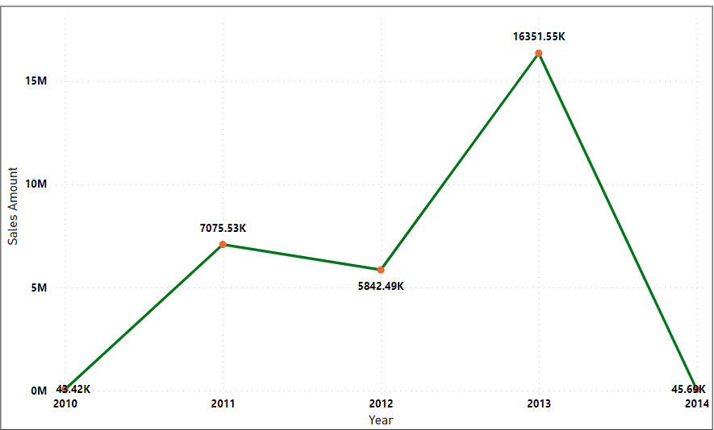
TOTAL SALES
KPI

Slide 7
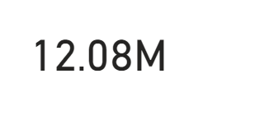
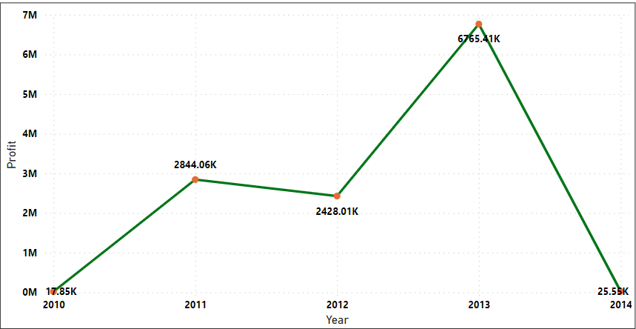
TOTAL PROFIT
KPI

Slide 8
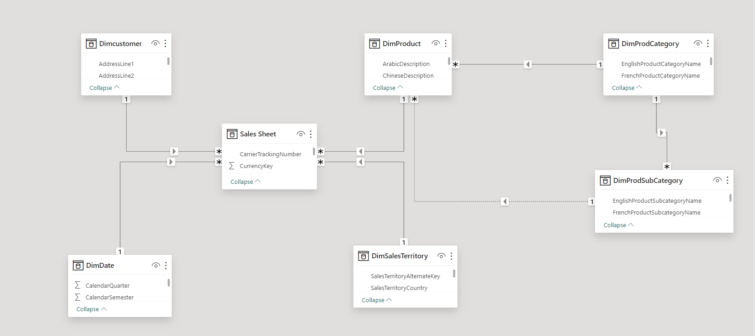
MODEL VIEW
It delineates the intricate relationship among product data, order information, sales regions, and customer details.

Slide 9
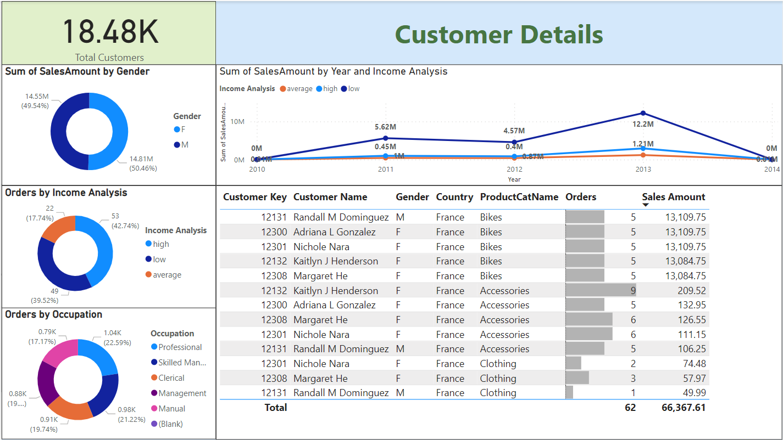
CUSTOMER ANALYSIS
The customer details image provides a comprehensive view of customer distribution across various regions within the sales country.

Slide 10
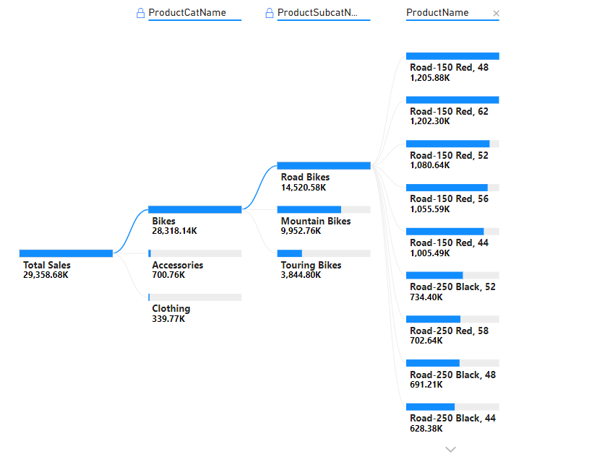
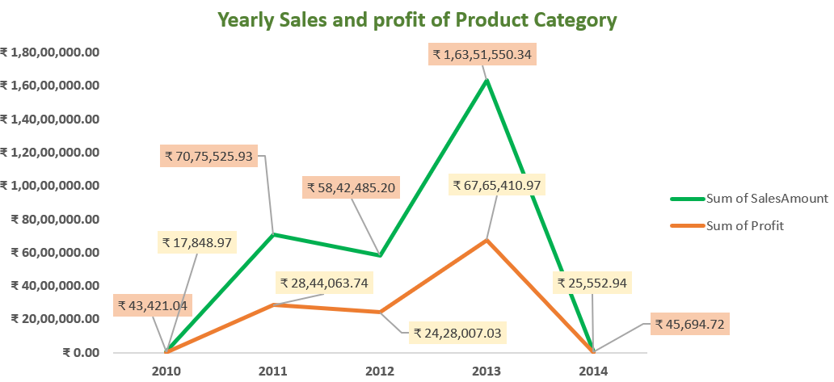
PRODUCT ANALYSIS
In the decomposition tree, we observe that Adventures Work Cycle's (AWC) total sales amount to 29,358K. Notably, the highest sales are attributed to Bikes, succeeded by Accessories and Clothing categories.
The line chart illustrates the annual sales and profits generated by AWC across its product categories: bikes, accessories, and clothing.

Slide 11
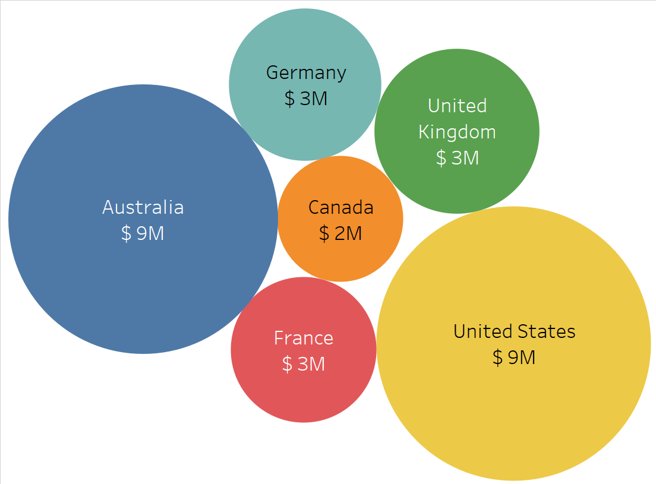
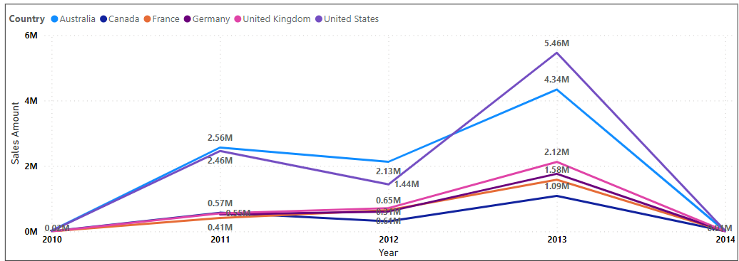
COUNTRYWISE SALES ANALYSIS
The image illustrates the sales distribution of AWC Company across various countries. Notably, it reveals that both the United States and Australia boast comparable total sales figures.

Slide 12

CONCLUSION
It was determined that AWC company's sales consistently exceeded production costs across all years, resulting in a favorable profit margin. Sales revenue was notably boosted by customers from the United States and Australia, contributing significantly to the company's financial success. From December 2013 to January 2014, the company demonstrated remarkable growth, consistently progressing with each subsequent year. The year 2013 witnessed a substantial surge in both sales and profits.

Slide 13
THANK YOU

